Slide 1


Synthesis of non-proteinogenic amino acids
Ivanka Jerić
Laboratory for Biomimetic Chemistry, Ruđer Bošković Institute

Slide 2
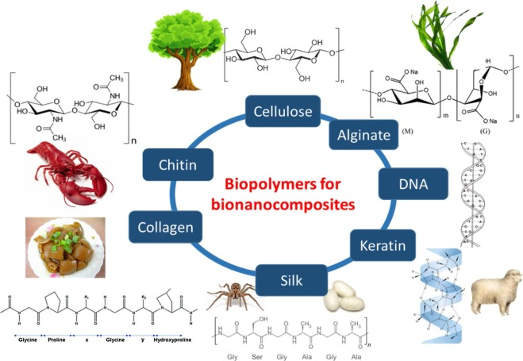
Natural products
Through the natural selection process, living organisms have developed highly sophisticated STRUCTURES, MATERIALS and PROCESSES, well adapted for the interaction with other living organisms or responses to unfavorable and threatening environmental conditions.
Biopolymers
Life as we know requires three basic types of polymers: proteins, polysaccharides, and polynucleotides.

Slide 3
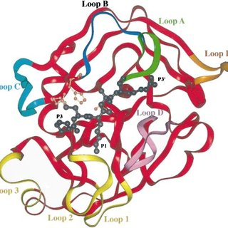
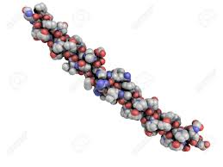
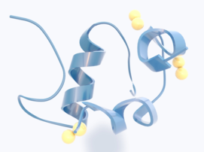
Peptides/proteins
Trypsin
Insulin
Collagen
Jasplakinolide
(marine sponge
induces apoptosis)
Tentoxine
(pathogenic fungus
herbicidal activity)
Radiosumine
(blue-green algae
protease inhibitor)

Slide 4
Peptides as therapeutics
Ixazomib (Ninlar)
(multiple myeloma)
Peptide catalyst
(desymmetrization of glycerols)
Peptide amphiphiles
(drug delivery)
Romidepsin (Istodax)
(cutaneous T-cell lymphoma)
Peptide catalyst
(Henry nitro-aldol reaction)
Biomaterials
(cell adhesion motif)

Slide 5
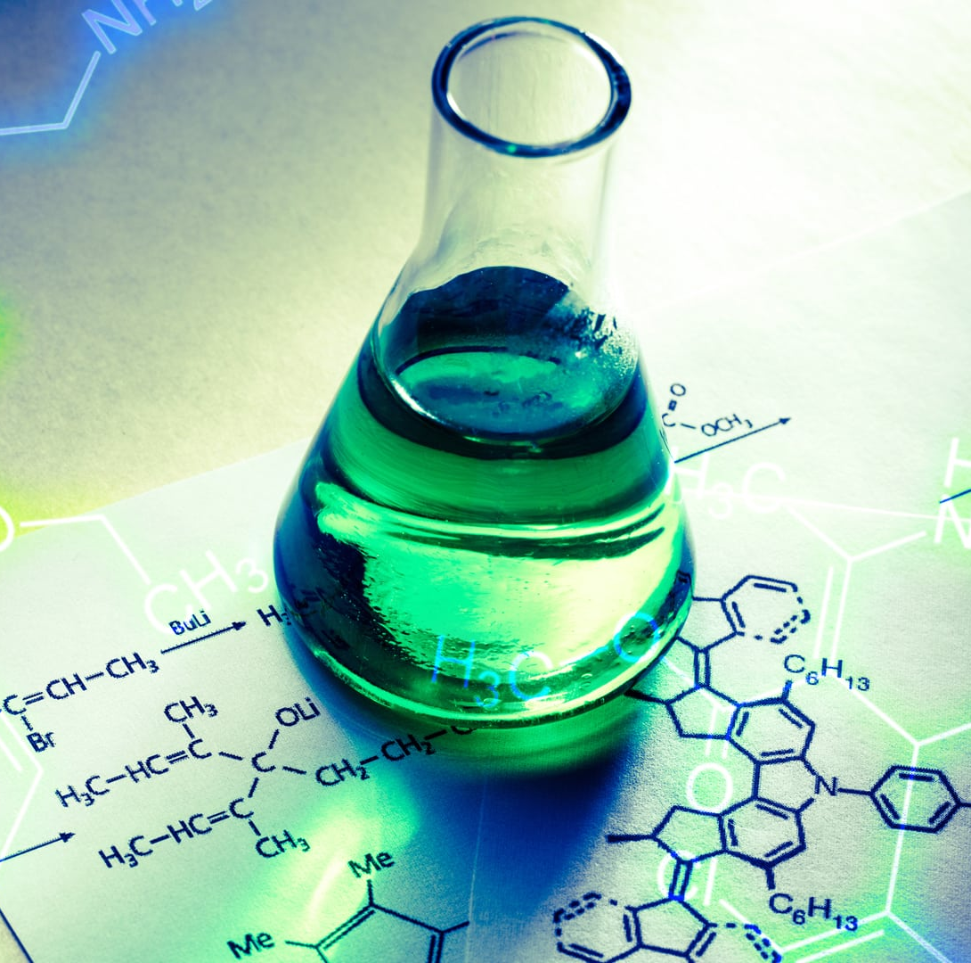
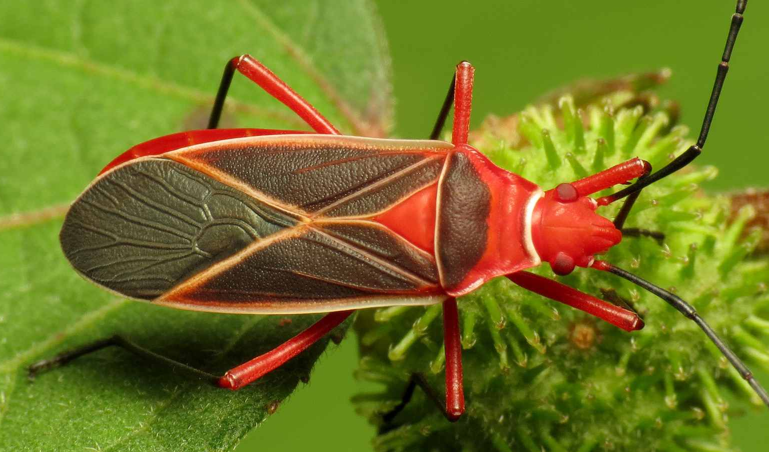
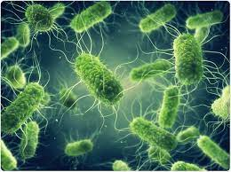
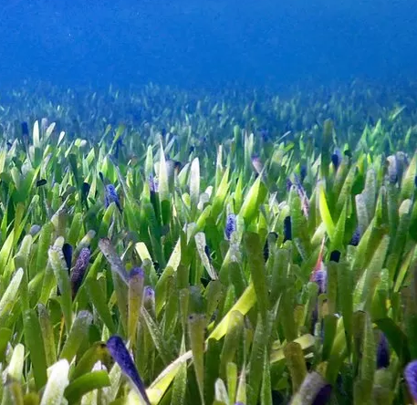
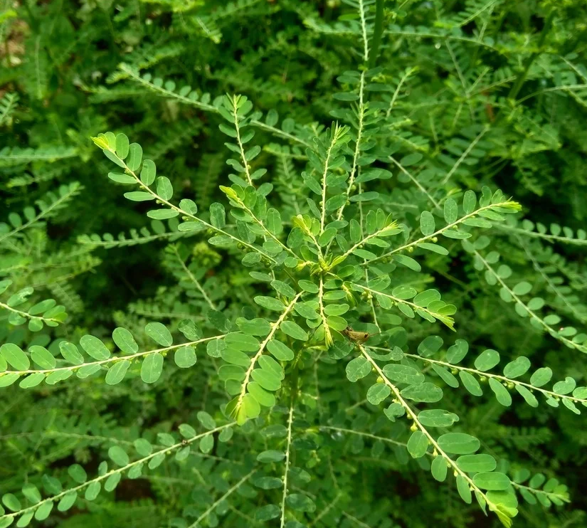
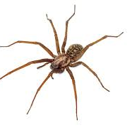
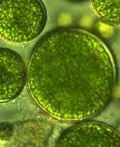
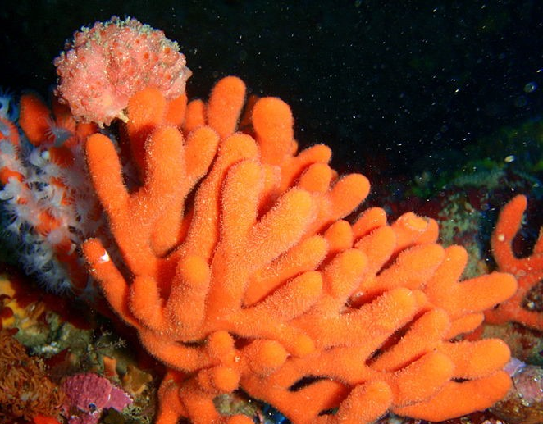
Bioconjugation
Medicinal chemistry
3’
3’
G U
A C
3’
5’
3’
Functional materials
Catalysis

Slide 6
examples

Slide 7
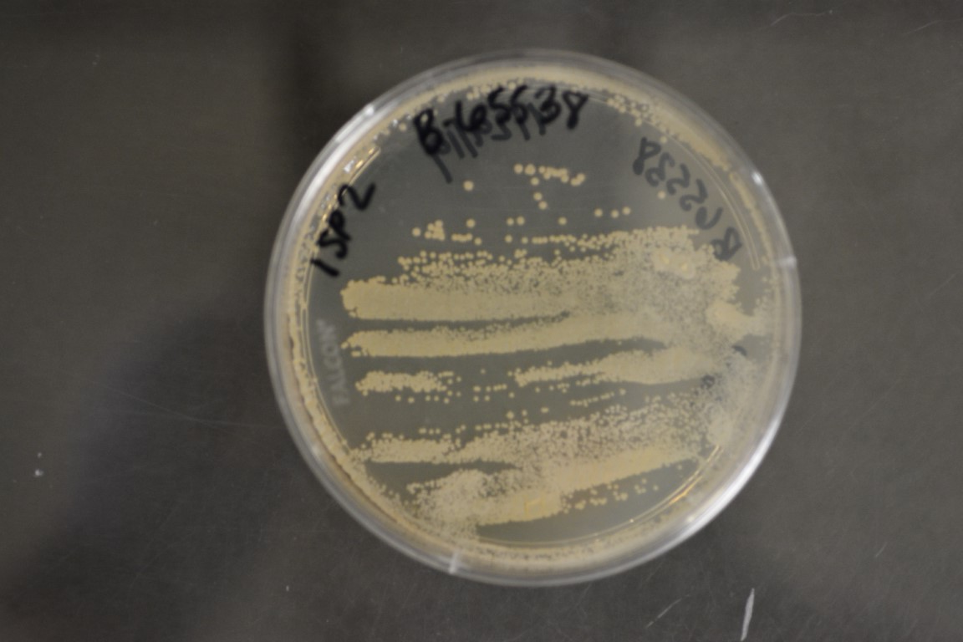
β-OH-Leu β-Me-Asp 2,3-Dab β-Phe Dpg diCl-Hpg
Angew. Chem. Int. Ed. 56 (2017) 3770–3821
Bacterial nonribosomal peptides
Piperazic acid (Piz)
β-sheet peptide conformation
Nat. Prod. Rep. 36 (2019) 1628−1653
Matlystatin B
metalloproteinase inhibitor

Slide 8
NPAAs in more than 30% of small molecule drugs
13/24 small molecule drugs approved by the FDA in 2019
2-(piperidin-4-yl)acetic acid
Progeria
Drugs 81 (2021) 283-289
Lonafarnib
farnesyl transferase inhibitor
NPAAs can improve the stability, efficacy, permeability and bioavailability of peptide-based therapeutics
lactoferricin
4-phenyl-phenylalanine
Acc. Chem. Res. 52 (2019) 749–759
Lactoferricin mimic
antimicrobial activity

Slide 9
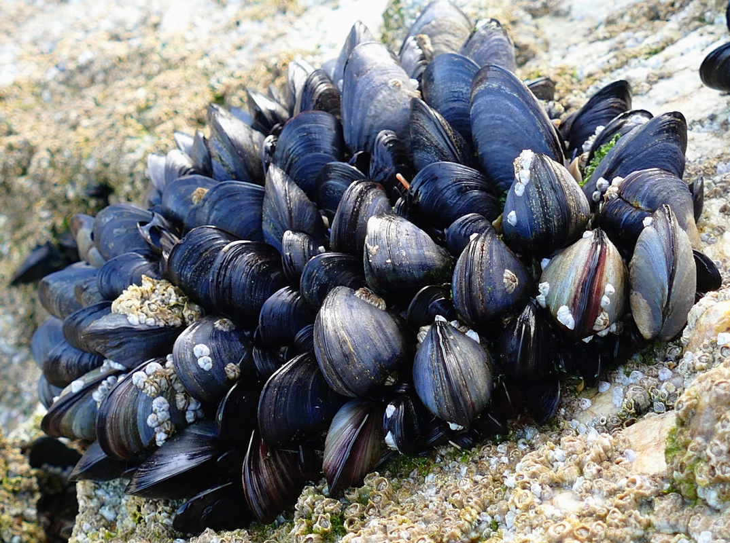
NPAAs with conformational constraints or hydrogen bond donors and acceptors
γ-aminoadamantanecarboxylic acid (AGly)
cyclohexylalanine (Cha)
kinetic resolution of trans-cycloalkane-1,2-diols by acylation
Chem. Rev. 120 (2020) 11479–11615
Peptide catalyst
acylation of trans-1,2-diols
Nature-inspired functional materials
di-3,4-dihydroxy‑L‑phenylalanine (DOPA)
self-organisation
Nat. Rev. Chem. 4 (2020) 615–634
DOPA-DOPA

Slide 10
Synthesis

Slide 11
From proteinogenic amino acids
Multicomponent approach
Mannich
Strecker
Chem. Soc. Rev. 41 (2012) 3969–4009

Slide 12
Catalytic asymmetric Strecker syntheses
Nature 461 (2009) 968-971
Eric N. Jacobsen

Slide 13
Electrophilic alkylations of glycine derivatives
Phase-Transfer Catalyst
Acc. Chem. Res. 37 (2004) 506–517

Slide 14
Asymmetric Hydrogenation of Enamides
Angew. Chem. Int. Ed. 41 (2002) 1998-2007
William S. Knowles

Slide 15
Asymmetric alkylation of the chiral Ni(II) complex of glycine Schiff bases
J. Org. Chem. 79 (2014) 7872−7879

Slide 16
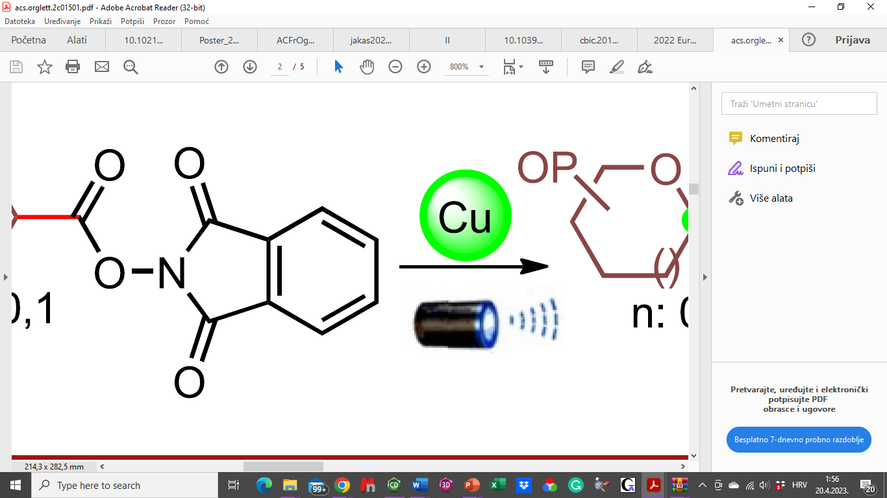
Redox chemistry
Org. Lett. 21 (2019) 3086–3092

Slide 17
Our contribution

Slide 18
N‑Substituted γ‑Lactams from glutamic acid
A potent compound with antibiofilm activity against Staphylococcus aureus identified.
J. Suć Sajko, V. Ljoljić Bilić, I. Kosalec, I. Jerić ACS Comb. Sci. 21 (2019) 28−34

Slide 19
N^{β}-Substituted 1,2-Diazetidin-3-ones (aza β-lactams) from α-hydrazino acids
S. Gedey, J. Van der Eycken, F. Fülöp, Org. Lett. 4 (2002) 1967–1969
J. Suć Sajko, I. Jerić, J. Org. Chem. 87 (2022) 7076-7084

Slide 20
Further structural decoration:

Slide 21
Carbohydrate-derived aldehydes in multicomponent reactions (MCRs)
Up to 89% yield
Up do 94:6 d.r.
S configuration
K. Vlahoviček-Kahlina, M. Vazdar, A. Jakas, V. Smrečki, I. Jerić, J. Org. Chem. 83 (2018) 13146-13156

Slide 22
Carbohydrate aldehydes
d.r.
90:10
80:20
75:25
75:25
d.r.
90:10
90:10
55:45
55:45
55:45
K. Vlahoviček-Kahlina, J. Suć Sajko, I. Jerić Int. J. Mol. Sci. 20 (2019) 6236
K. Vlahoviček-Kahlina, Z. Štefanić, K. Vazdar, I. Jerić, Chempluschem 85 (2020) 838–844
A. Jakas, A. Višnjevac, I. Jerić, J. Org. Chem. 85 (2020), 3766-3787
A. Jakas, R. Ayyalasomayajula, M. Cudic, I. Jerić, Glycoconjugate J. 39 (2022) 587-597

Slide 23
C-glycosyl α-amino acids
LINKER
R or S
α-amino acids
β-amino acids
γ-amino acids
R or S
Side-chain
modification
Type I oligomers
homo- vs heterochiral
Type II oligomers
homo- vs heterochiral
Influence of C-glycosyl α-amino acid

Slide 24
Methodology:
Passerini reaction hydrolysis OH to NH₂ transformation
Passerini reaction hydrolysis OH to NH₂ transformation

Slide 26
Ivana Colić
heterochiral vs homochiral

Slide 27
Carbohydrates
Carbasugars
Tamiflu®
Acarbose

Slide 28
Chemistry and Chemical Biology I–III (2001) pp 2595–2661
Org. Biomol. Chem. 17 (2019) 4061–4072

Slide 30
Next ...... oligomers-conformation-properties.... Structure-activity relationship

Slide 31
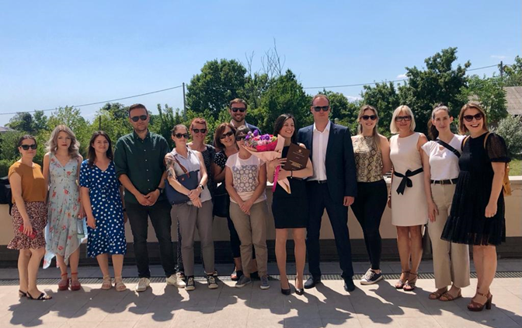



Acknowledgment
Josipa Suć Sajko
Kristina Vlahoviček-Kahlina
Andreja Jakas
Milica Perc
Ivana Colić
Barbara Bogović
Mario Vazdar
Vilko Smrečki
Aleksandar Višnjevac
Ana Čikoš
Ivan Kosalec
Vanja Ljoljić Bilić
Laboratory for biomimetic chemistry
ivanka.jeric@irb.hr
matija.gredicak@irb.hr
nikola.topolovcan@irb.hr

